Slide 1
Connecting you to timely scientific research
Accucoms 中国

Slide 2
目录
BioOne 出版社介绍
BioOne Complete 数据库介绍
BioOne 使用指南

Slide 3
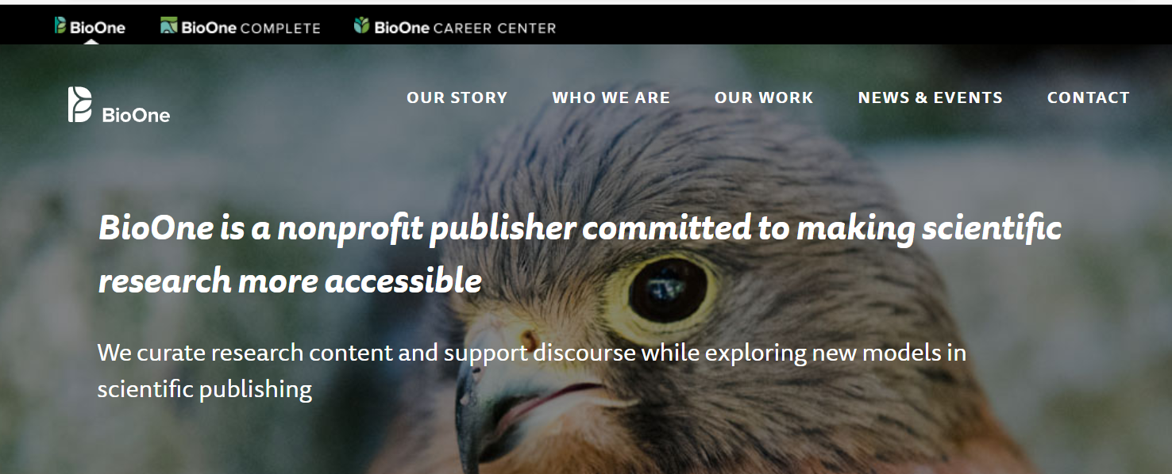
关于 BioOne
  BioOne 成立于1999年，是一个由多家著名大学赞助，由各学协会、高校与出版社联合组成的非营利组织
  是一个在生物科学研究领域具有高影响力的期刊整合联盟
Notes:
BioOne Complete is the full-text database of 200 titles from over 150 society and independent publishers in the biological, ecological, and environmental sciences. The collection offers comprehensive coverage of fields such as zoology, plant sciences, ornithology, and entomology, with new content added daily.

Slide 4
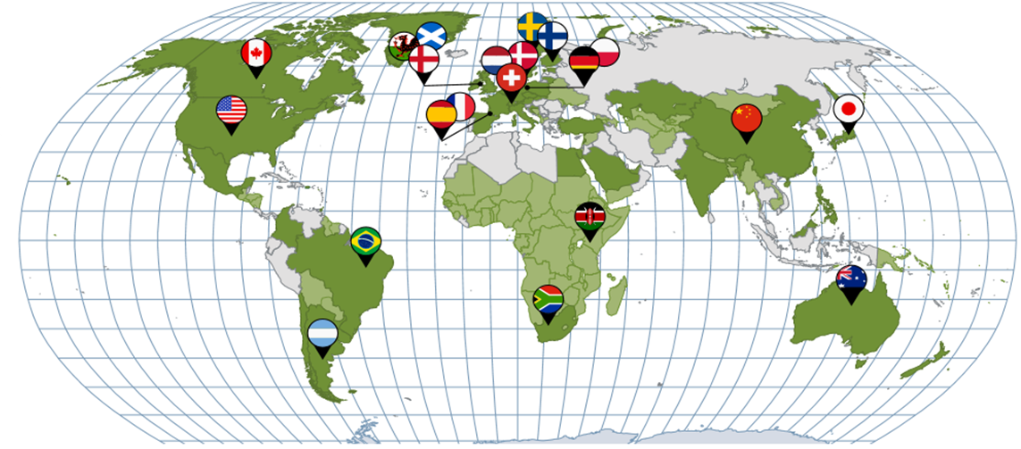
关于 BioOne
  内容来自于155家非商业出版社和学协会，服务于全球4000家图书馆
Notes:
BioOne Complete is the full-text database of 200 titles from over 150 society and independent publishers in the biological, ecological, and environmental sciences. The collection offers comprehensive coverage of fields such as zoology, plant sciences, ornithology, and entomology, with new content added daily.

Slide 5

关于 BioOne
  创立者包括：
  Allen Press
  美国生物科学研究所（The American Institute of Biological Sciences，AIBS）
  美国西部图书馆联盟（Greater Western Library Alliance）
  美国肯萨斯大学（The University of Kansas）
  学者出版及学术资源联盟（Scholarly Publishing & Academic Resources Coalition，SPARE）
Notes:
BioOne Complete is the full-text database of 200 titles from over 150 society and independent publishers in the biological, ecological, and environmental sciences. The collection offers comprehensive coverage of fields such as zoology, plant sciences, ornithology, and entomology, with new content added daily.

Slide 6
关于 BioOne
BioOne不仅仅是一个数据库，它将作者、出版商、专业协会、学术机构、图书馆和研究者联系起来，持续为研究人员提供具有高影响力的生物科学研究资源，为图书馆提供具有成本效益的馆藏内容，把众多学术出版商的资源进行整合，BioOne为大家提供了一个动态的、高质量的生物科学的期刊联盟的平台，以求最大限度地帮助读者实现及时、全面、有效的获取研究内容的共同目标。
Notes:
BioOne Complete is the full-text database of 200 titles from over 150 society and independent publishers in the biological, ecological, and environmental sciences. The collection offers comprehensive coverage of fields such as zoology, plant sciences, ornithology, and entomology, with new content added daily.

Slide 7
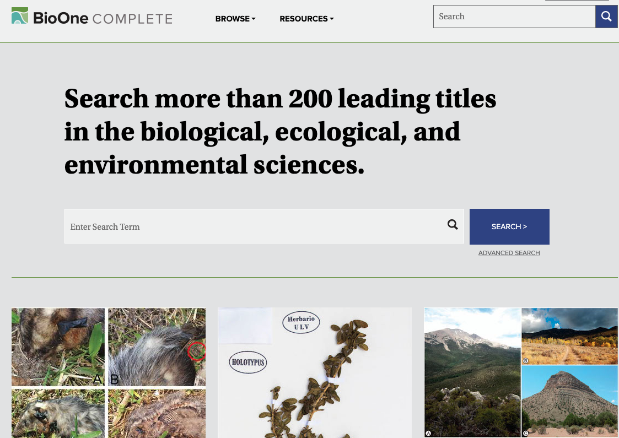
BioOne Complete is…
  独立出版期刊的全文数据库
  专注于生物学、生态学和环境科学等学科
  为您的图书馆提供来源可靠的科学研究
  集中了鸟类学、爬虫学、昆虫学和生物多样性保护领域的领先期刊
Notes:
BioOne Complete is the full-text database of 200 titles from over 150 society and independent publishers in the biological, ecological, and environmental sciences. The collection offers comprehensive coverage of fields such as zoology, plant sciences, ornithology, and entomology, with new content added daily.

Slide 8
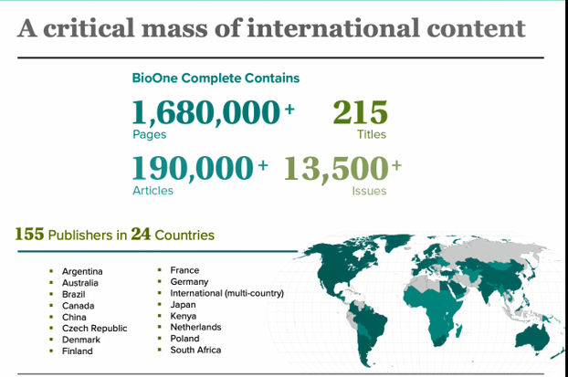
Stats & Facts

Slide 9
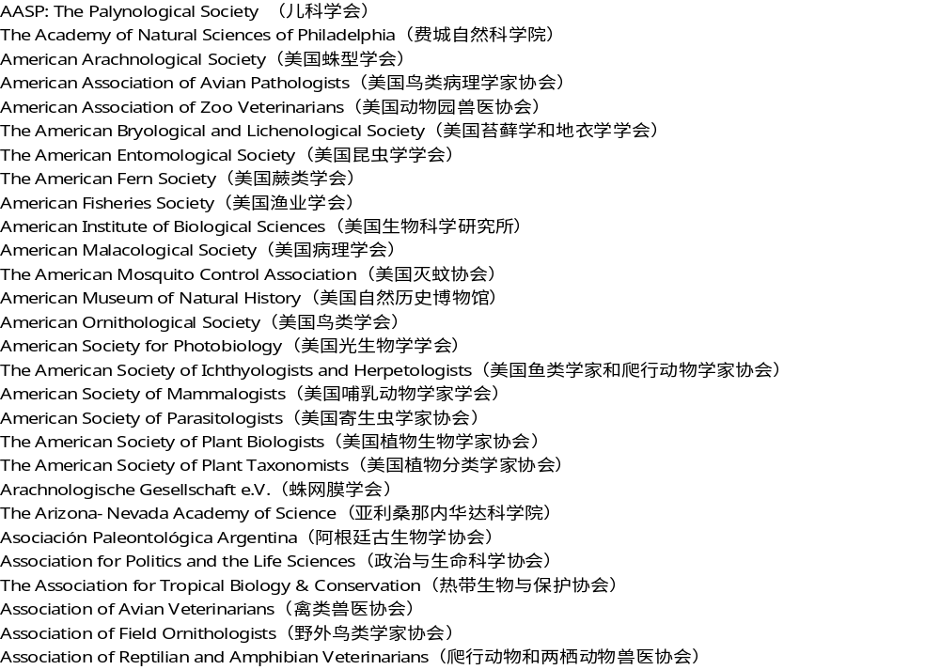
涵盖学协会：
Notes:
BioOne Complete is the full-text database of 200 titles from over 150 society and independent publishers in the biological, ecological, and environmental sciences. The collection offers comprehensive coverage of fields such as zoology, plant sciences, ornithology, and entomology, with new content added daily.

Slide 10





Who subscribes?
世界上最著名的大学、科学机构、研究中心和智库
63%
of the top 100 universities around the world subscribe to BioOne Compete
    Chinese Academy of Sciences, China
    French National Centre for Scientific Research, France (CNRS)
    Max Planck Society, Germany
    Polish Academy of Sciences, Poland
    National Institutes of Health, United States
    University of São Paulo, Brazil
    University of Toronto, Canada
    University of Oxford, United Kingdom
    ETH Zurich – Swiss Federal Institute of
    Technology Zurich, Switzerland
    University of Hong Kong, Hong Kong
    The University of Tokyo, Japan
    University of Amsterdam, Netherlands
    Peking University, China
Notes:
Rameez Ali’s analysis of BioOne Complete subscribers in the top 100 universities around the globe according to the Times higher education 2018 website (July 2018).
8 out of the top 10 universities in the world subscribe to BioOne Complete, including both first and second ranked University of Oxford and University of Cambridge,
In the United States 7 out of the top 10 universities subscribe to BioOne Complete, including Stanford, Harvard and Princeton Universities
BioOne Complete Subscribers from the top ranked universities in the world:
https://www.timeshighereducation.com/world-university-rankings/2018/world-ranking
University of Oxford
University of Cambridge
Stanford University
Harvard University
Princeton University
Imperial College London
University of Chicago
ETH Zurich – Swiss Federal Institute of Technology Zurich
University of Pennsylvania

Slide 11
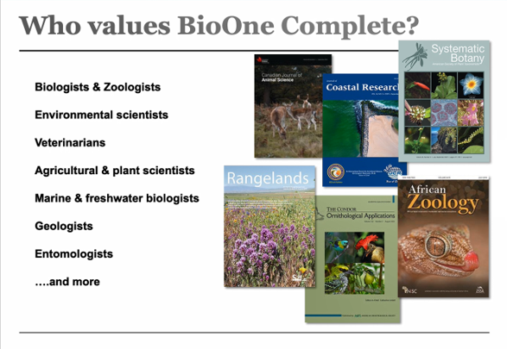
Subject Coverage

Slide 12
Stats & Facts

Slide 13
Subject Coverage
农业
乳制品与畜牧学
农业经济学
生物学
生物化学
生物物理学
分子生物学
生物多样性保护
细胞生物学
发育生物学
生态学
工程学
环境科学
昆虫学
进化生物学
基因、遗传学
水产学
林学
地理学
地质学
湖沼学
海洋与淡水生物学
微生物学
鸟类学
古生物学
寄生虫学
植物学
公共环境与职业卫生学
运动科学
兽医学
动物学

Slide 14
Subject Coverage
Journal Citation Report Data*
  BioOne Complete 主要涵盖在以下几个核心领域：
    鸟类学 : 10 BioOne Complete titles out of 28 total ranked (36%)
    昆虫学 : 24 BioOne Complete titles out of 101 total ranked (24%)
    生物多样性保护: 13 BioOne Complete titles out of 59 total ranked (22%)
    古生物学 : 12 BioOne Complete titles out of 55 total ranked (22%)
    生态学 : 26 BioOne Complete titles out of 168 total ranked (15%)
    动物学 : 33 BioOne Complete titles out of 168 total ranked (20%)
    植物科学: 30 BioOne Complete titles out of 234 total ranked (13%)
    * 2019 Journal Citation Report Data (Clarivate, 2020)
Notes:
Updated June 2018,
2017 Journal Citation Report Data
Each year BioOne enhances its category concentration in many of its core fields, further demonstrating its exceptional value for librarians seeking subject area coverage at a fraction of commercial subscription rates.
BioOne Complete features 147 out of 182 subscribed titles (81%) - our highest percentage ever!
We have some very impressive subject category concentrations, including ornithology (10 of 25 titles ranked) and entomology (24 of 96 titles ranked). We also have the number one title in ornithology (Condor).
The average cited half life for our ranked titles continues at 9.1 years. This is a bit imprecise, as to do an average I had to make the >10.0 just "10.0" proper. However, it still is an excellent indication of just how long the research in our titles is cited, and thus emphasizes the value of BioOne's archival content to subscribers.

Slide 15
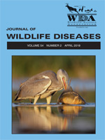
Featured Titles
Most accessed journals
      International Mountain Society
        Mountain Research and Development
      American Ornithological Society
        The Auk
      Coastal Education and Research Foundation
        Journal of Coastal Research
      Wildlife Disease Association
        Journal of Wildlife Diseases
      The American Society of Ichthyologists and Herpetologists
        Copeia
      American Association of Zoo Veterinarians
        Journal of Zoo and Wildlife Medicine
      American Society of Parasitologists
        Journal of Parasitology
      Weed Science Society of America
        Weed Science
      Radiation Research Society
        Radiation Research
      National Association of Biology Teachers
        The American Biology Teacher
      Zoological Society of Japan
        Zoological Science
    2015: Journal of Wildlife Diseases debuts in BioOne Complete
    full run of issues dating
    back to Vol 1 (1965)
    current holdings:
    213 issues : 6,148 articles : 36,185 pages
    open access: Vol 3 (1965) - Vol 46 : 2010
Notes:
Selection of top accessed active titles in 2017
To customize this slide for a presentation, swap the cover image and stats to highlight a particular discipline:
Mountain Research and Development / International Mountain Society
Geology & Paleontology, Environmental Sciences
Florida Entomologist / Florida Entomological Society
Entomology, Ecology
Journal of Zoo and Wildlife Medicine / American Association of Zoo
Veterinarians Zoology, Veterinary Sciences, Entomology
The Auk American / Ornithological Society
Ornithology
Journal of Wildlife Diseases / Wildlife Disease Association
Entomology, Veterinary Sciences, Zoology
Zoological Science / Zoological Society of Japan
Environmental Sciences, Zoology
Journal of Coastal Research / Coastal Education and Research Foundation
Geology & Paleontology, Environmental Sciences, Marine & Freshwater Biology
The Condor / American Ornithological Society
Ornithology
Journal of Parasitology / American Society of Parasitologists
Veterinary Sciences, Entomology
Radiation Research / Radiation Research Society
Biology, Environmental Science
Avian Diseases / American Association of Avian Pathologists
Ornithology, Veterinary Sciences
Weed Science / Weed Science Society of America
Agriculture & Agronomy, Plant Sciences
The American Biology Teacher / National Association of Biology Teachers
Environmental Sciences, Biology
Weed Technology / Weed Science Society of America
Agriculture & Agronomy, Plant Sciences
Copeia / American Society of Ichthyologists and Herpetologists
Evolutionary Biology, Zoology

Slide 16
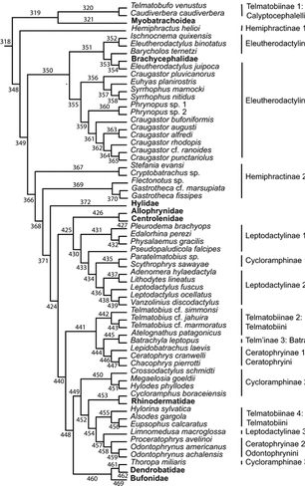
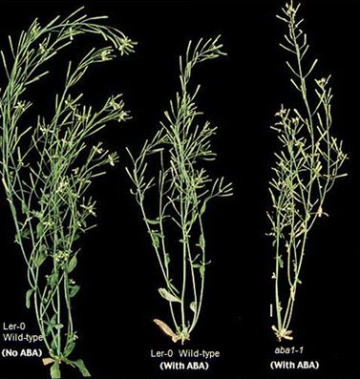
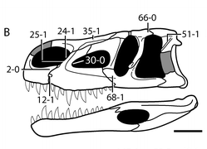
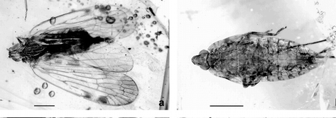
Highly Cited Papers
      Weed Science
        Reducing the Risks of Herbicide Resistance: Best Management Practices and Recommendations
      American Museum Novitates
        Fossiliferous Cretaceous Amber from
        Myanmar (Burma): Its Rediscovery,
        Biotic Diversity, and Paleontological Significance
      Radiation Research
        Solid Cancer Incidence in Atomic Bomb
        Survivors: 1958–1998
      The Arabidopsis Book
        Abscisic Acid Synthesis and Response
      Bulletin of the American Museum of Natural History
        The Early Evolution of Archosaurs:
        Relationships and the Origin of Major Clades
      Journal of Parasitology
        Quantifying Parasites in Samples of Hosts
Notes:
Top articles in BioOne Complete referenced by other scholarly papers over a three year period.
Data is harvested from Crossref's Cited-by Linking service.

Slide 17
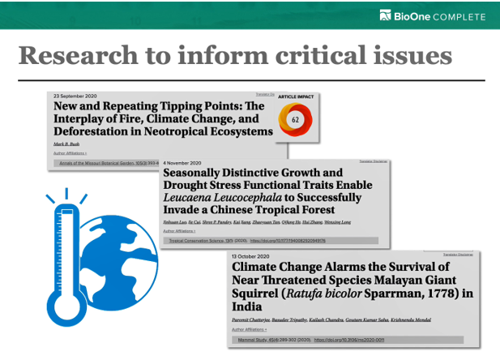
Highly Cited Papers
Notes:
Top articles in BioOne Complete referenced by other scholarly papers over a three year period.
Data is harvested from Crossref's Cited-by Linking service.

Slide 18
Get Started with BioOne Complete
使用说明

Slide 19
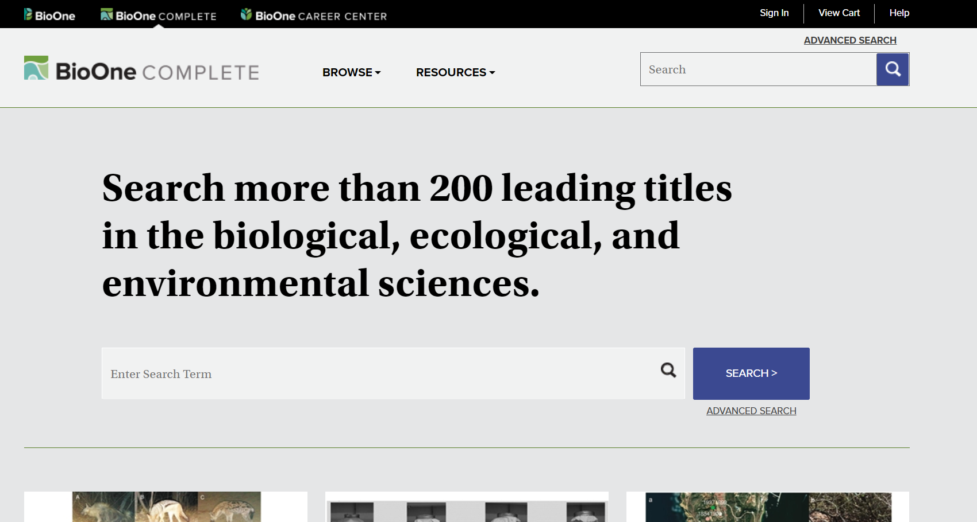
BioOne主页导航
通过资源检索，找到BioOne数据库。无需登陆，图书馆已购买了数据库。

Slide 20
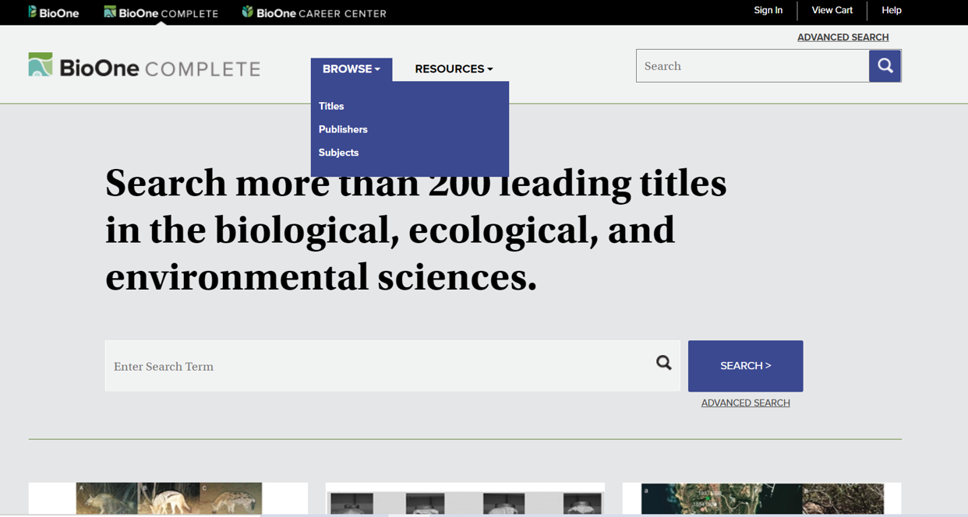
BioOne主页导航
分类浏览
基础检索高级检索

Slide 21
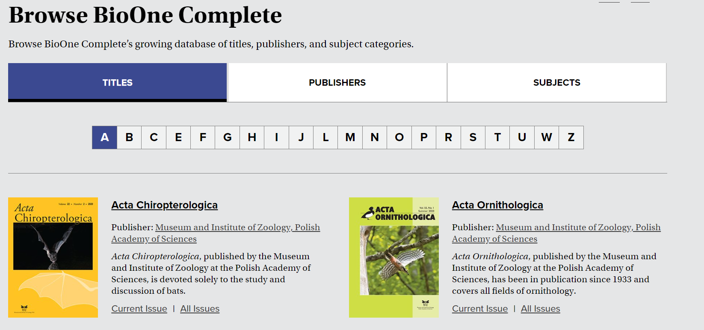
BioOne Complete 浏览功能
按刊名浏览

Slide 22
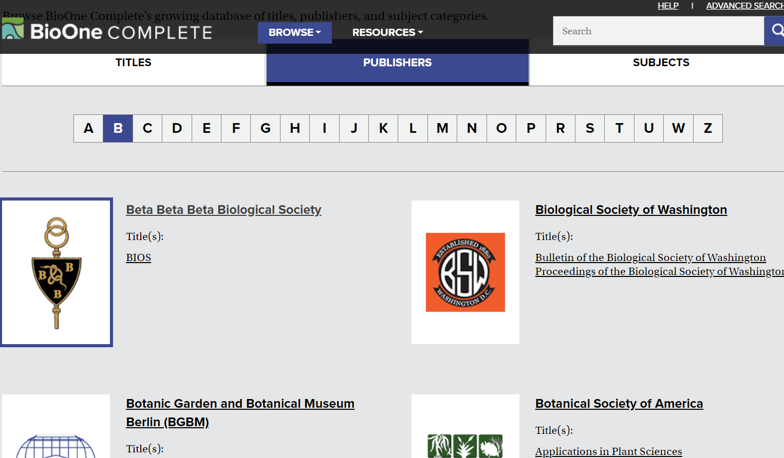
BioOne Complete 浏览功能
按出版社浏览

Slide 23
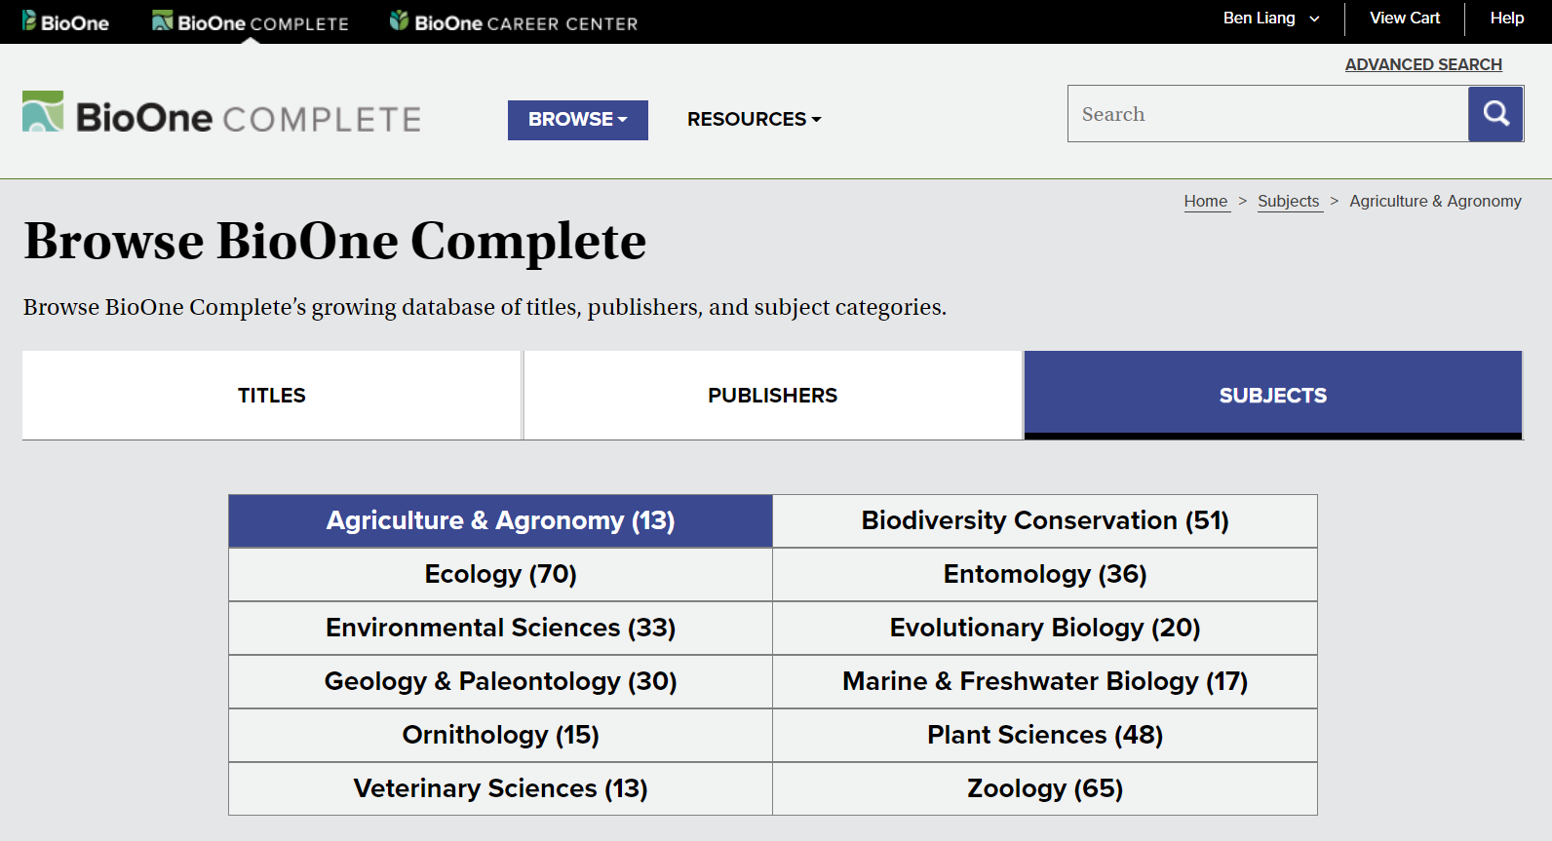
BioOne Complete 浏览功能
按学科浏览

Slide 24
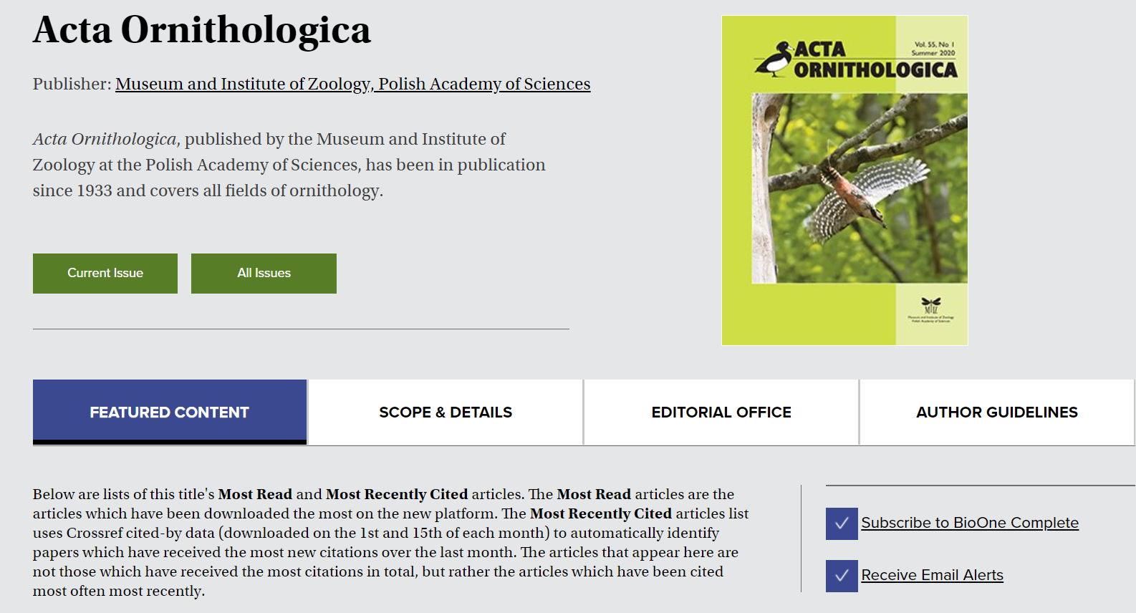
BioOne Complete 期刊浏览
可浏览现刊及往期过刊

Slide 25
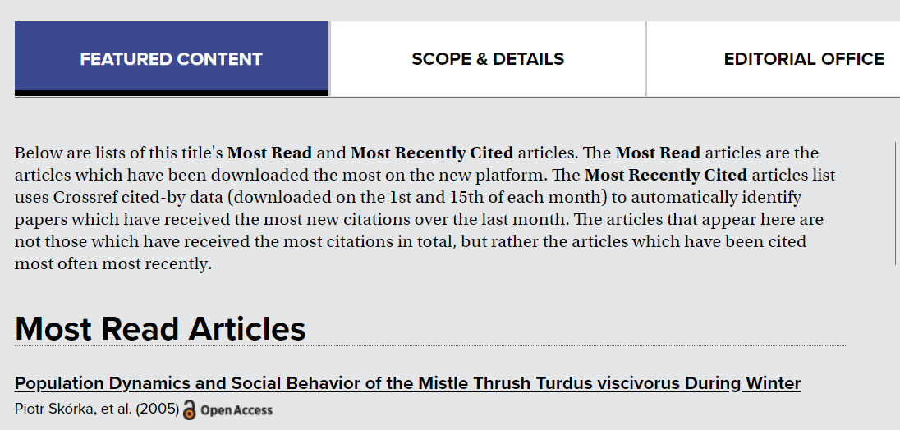
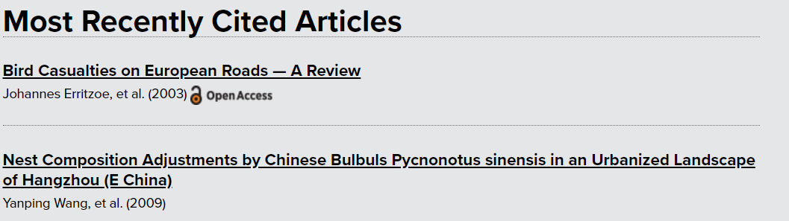
BioOne Complete 期刊浏览
阅读最多的文章是指平台上下载最多的文章
最近被引用最多的文章

Slide 26
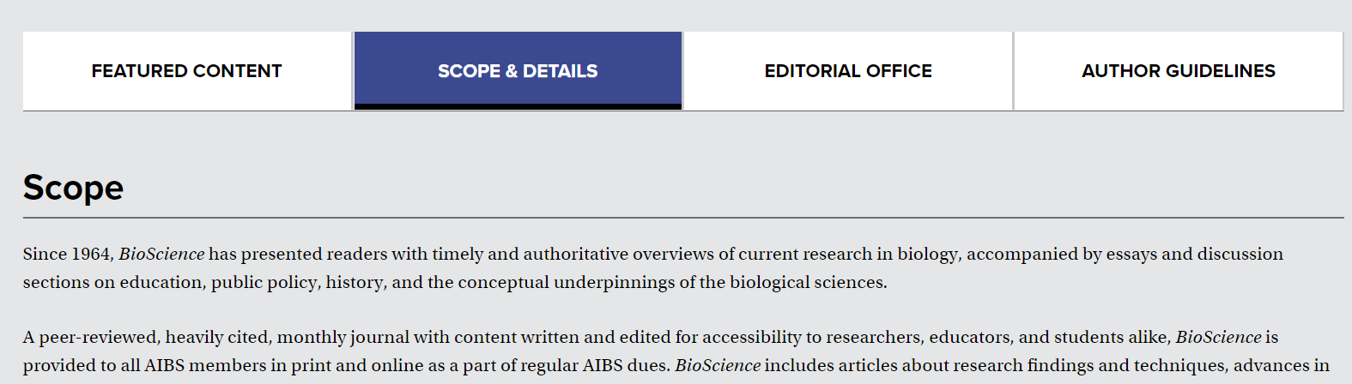
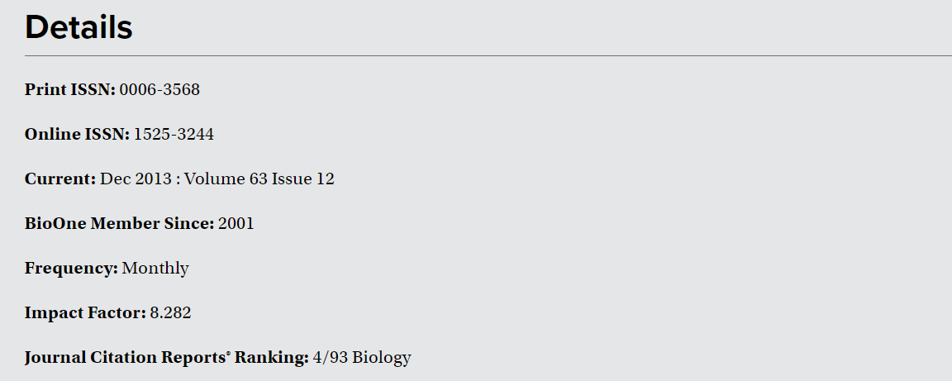
BioOne Complete 期刊浏览

Slide 27
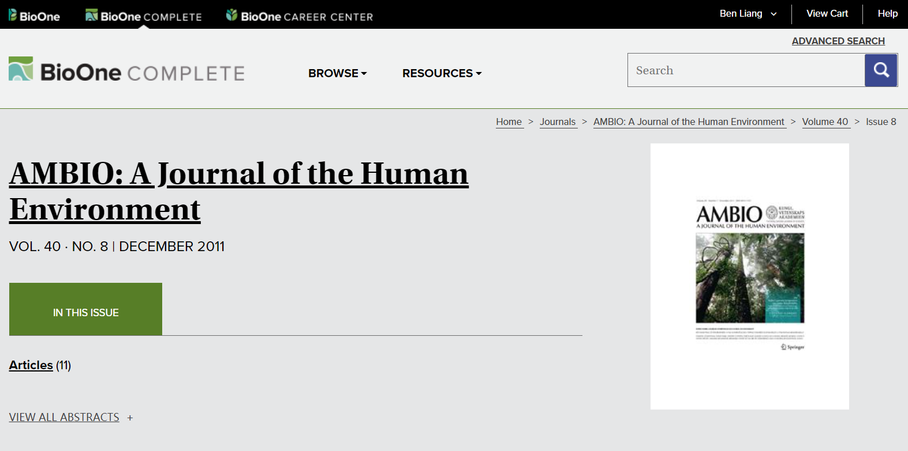
BioOne Complete 篇章浏览
点击浏览文章和摘要

Slide 28
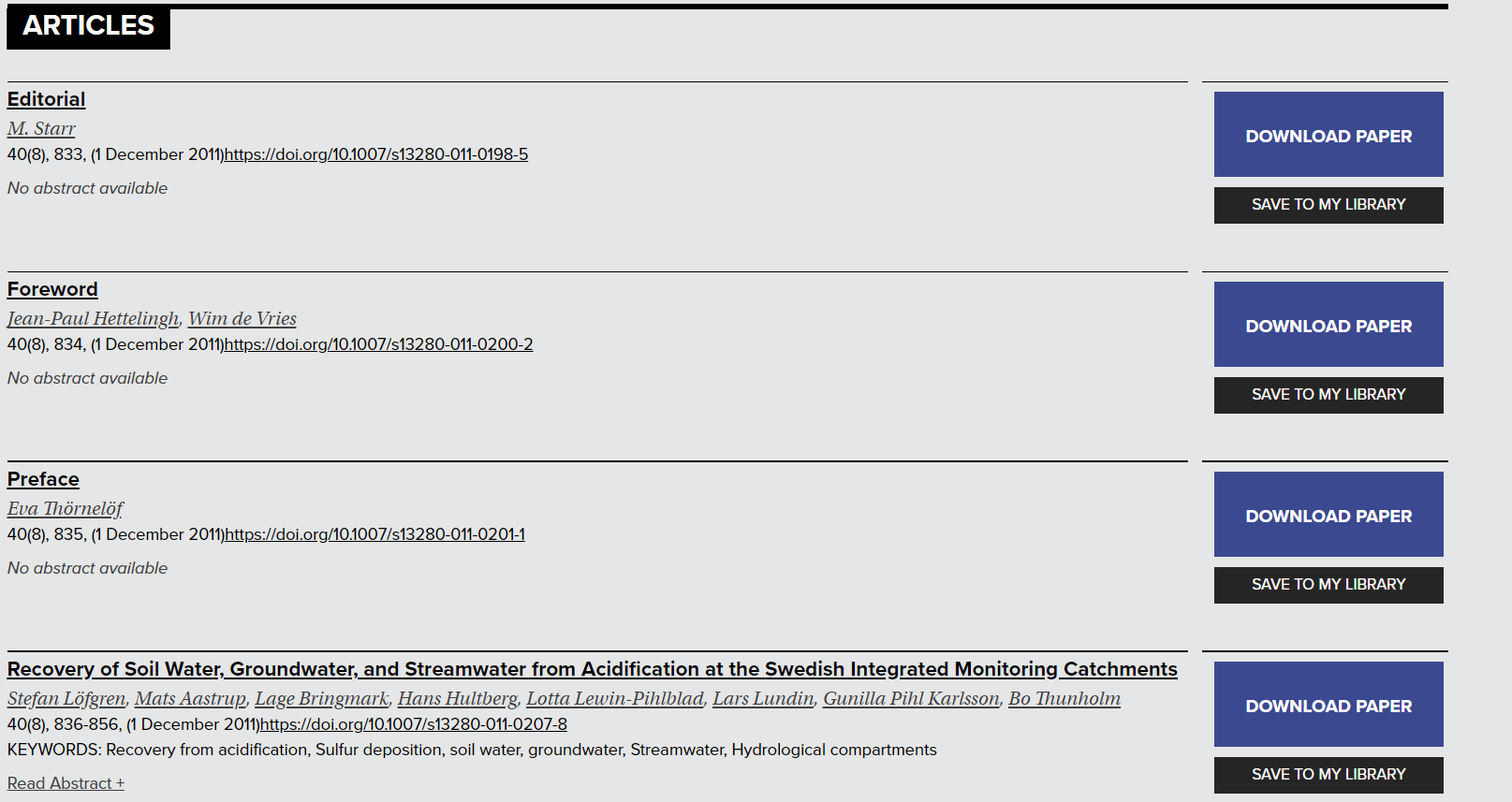
BioOne Complete 篇章浏览
选择下载相关文章或保存至个人帐户的“我的图书馆”

Slide 29
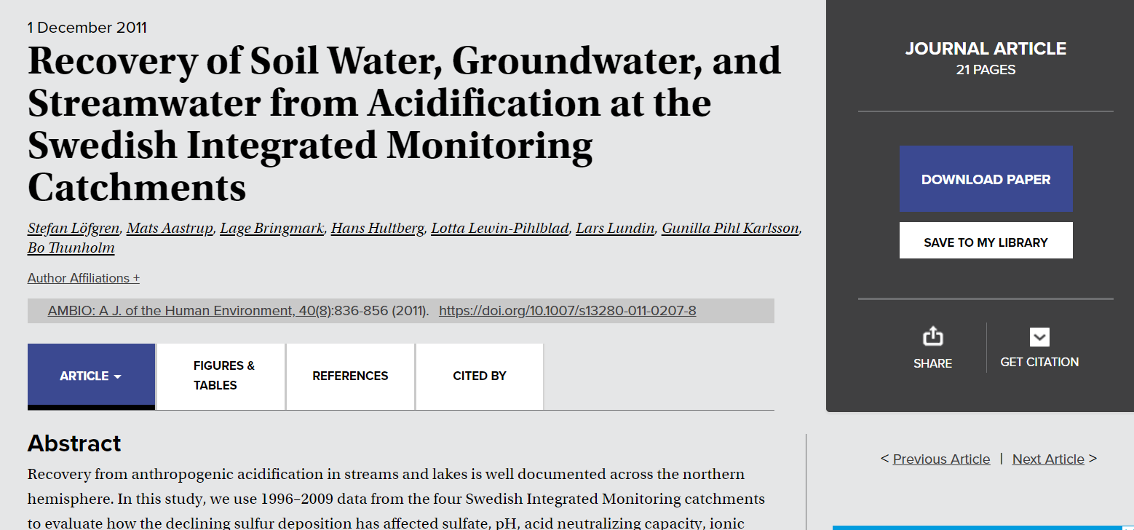
BioOne Complete 篇章浏览
浏览全篇文章及下载
文章、图表、参考文献及引用情况
导出引文或文摘
通过邮件或社交媒体分享文章链接

Slide 30
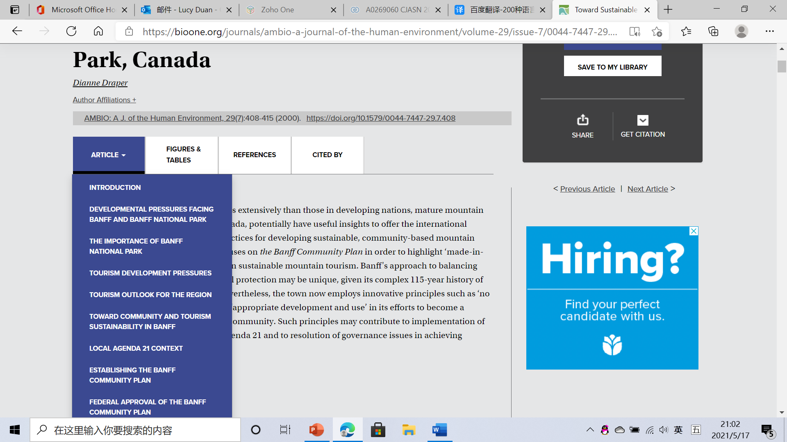
BioOne Complete 篇章浏览
浏览文章的不同部分内容

Slide 31
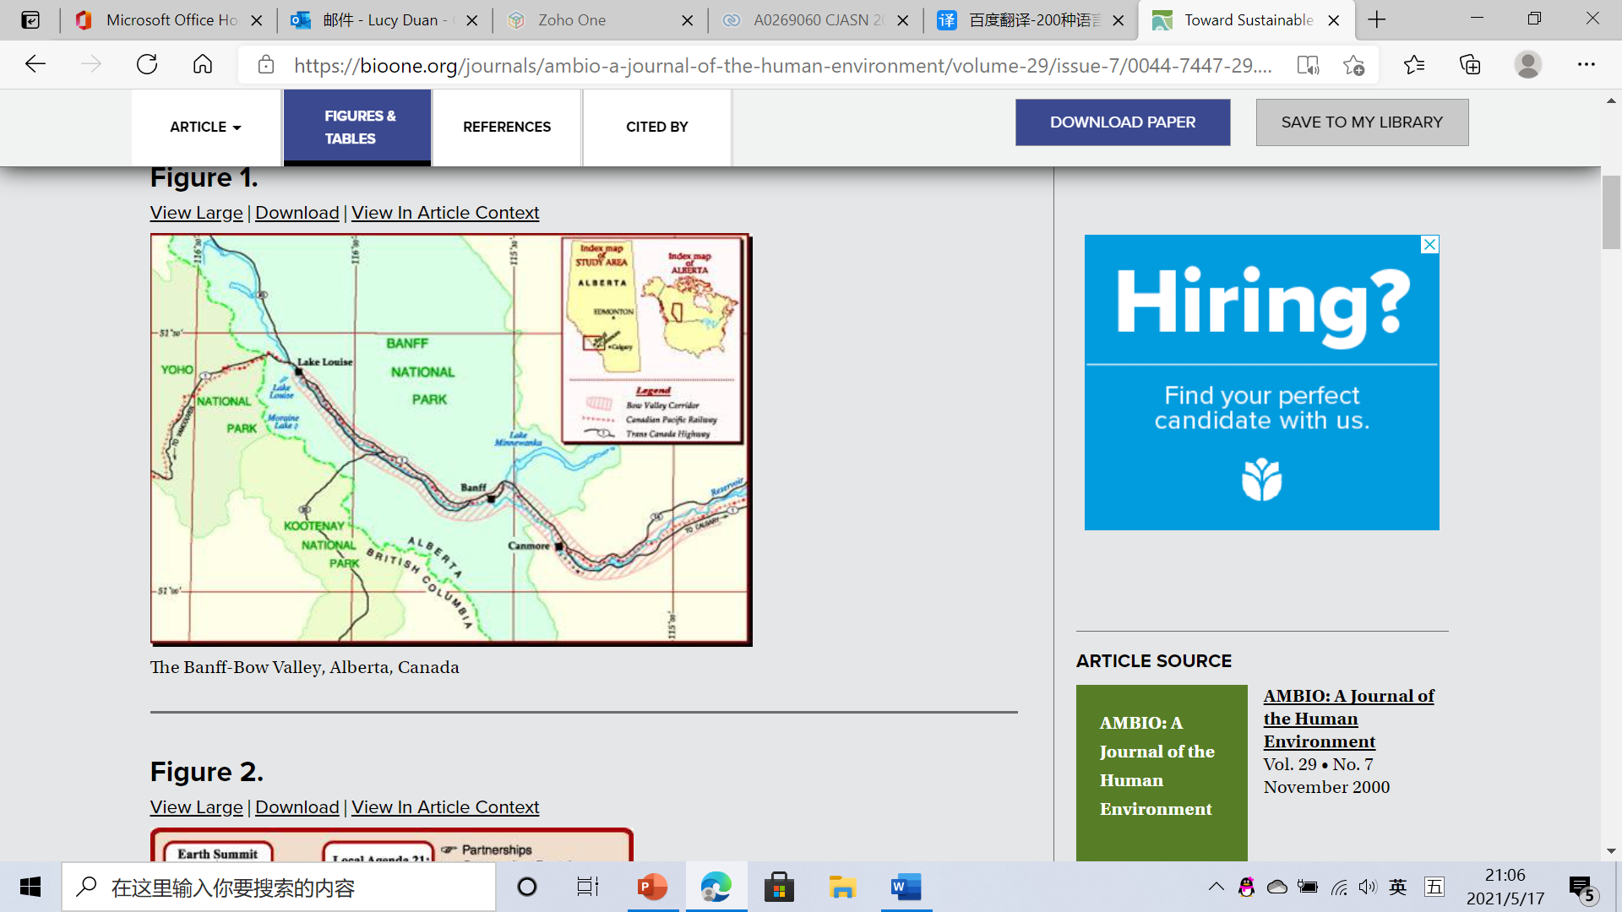
BioOne Complete 篇章浏览
该篇文章所包含的各种图表

Slide 32
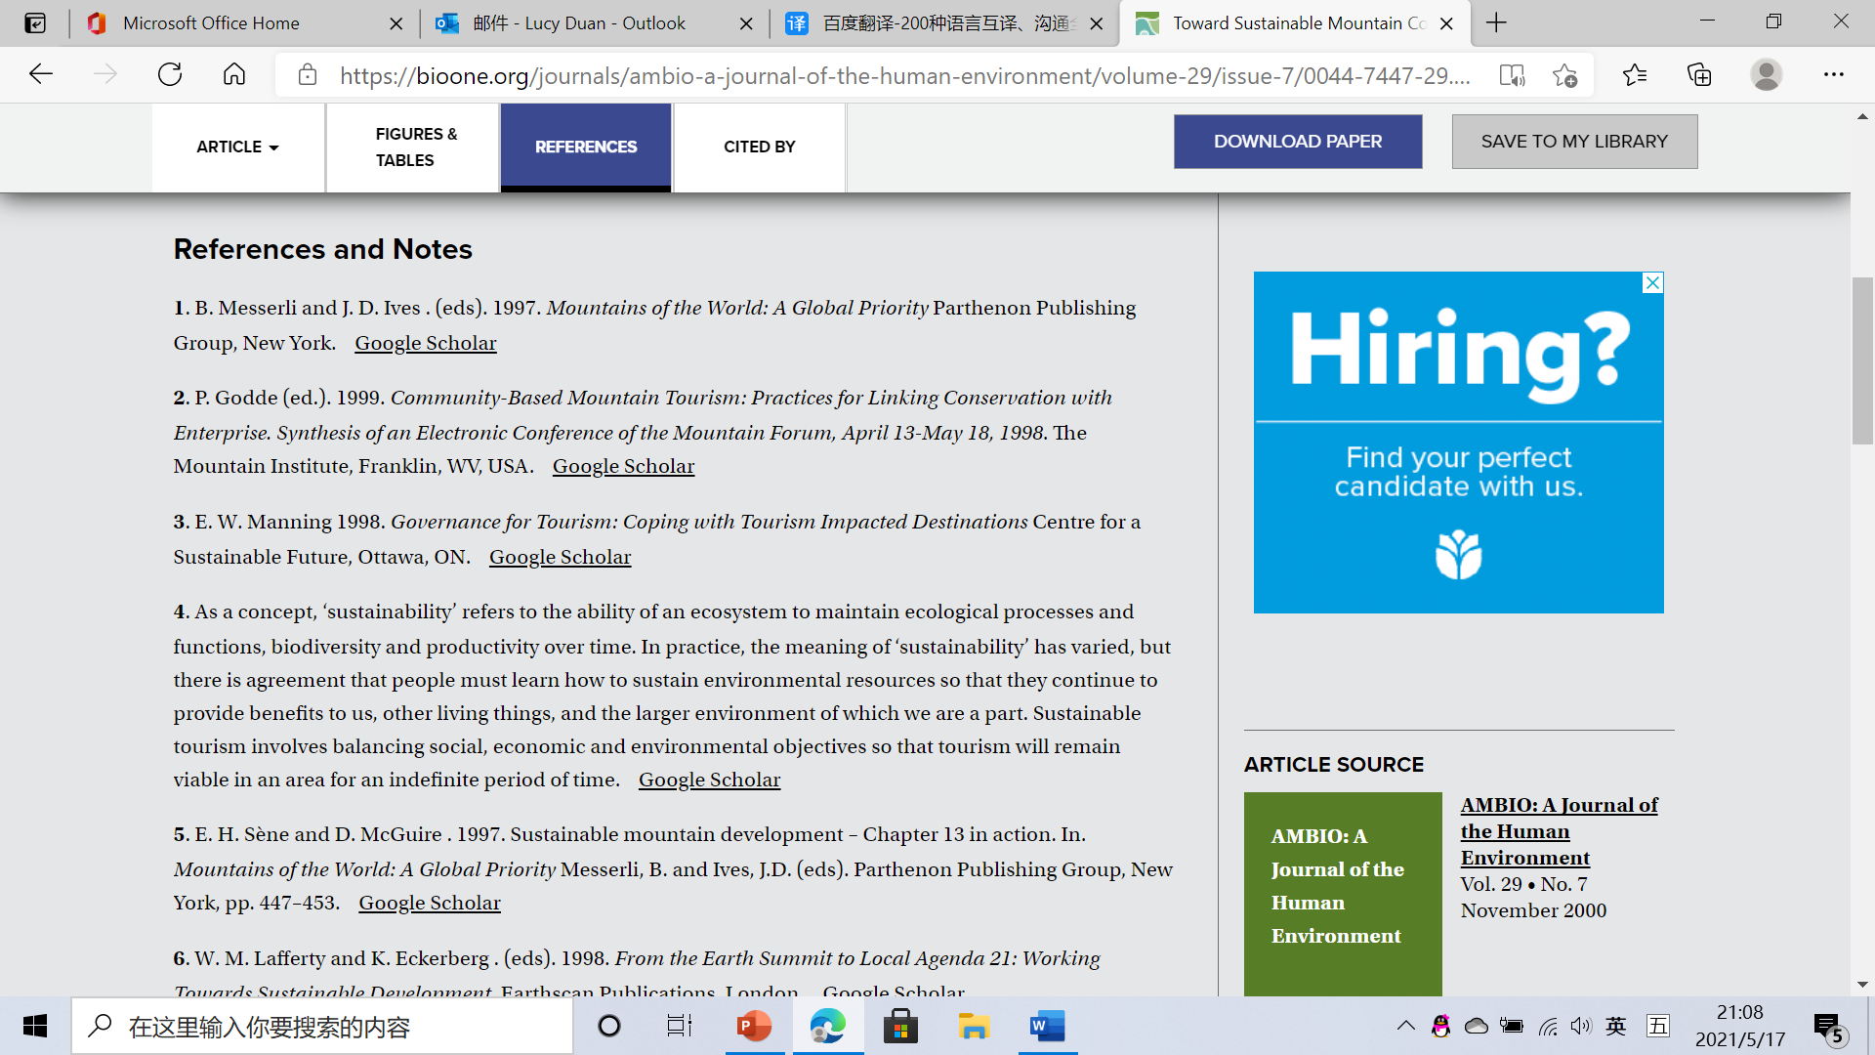
BioOne Complete 篇章浏览
该篇文章所涉及到的参考文献

Slide 33
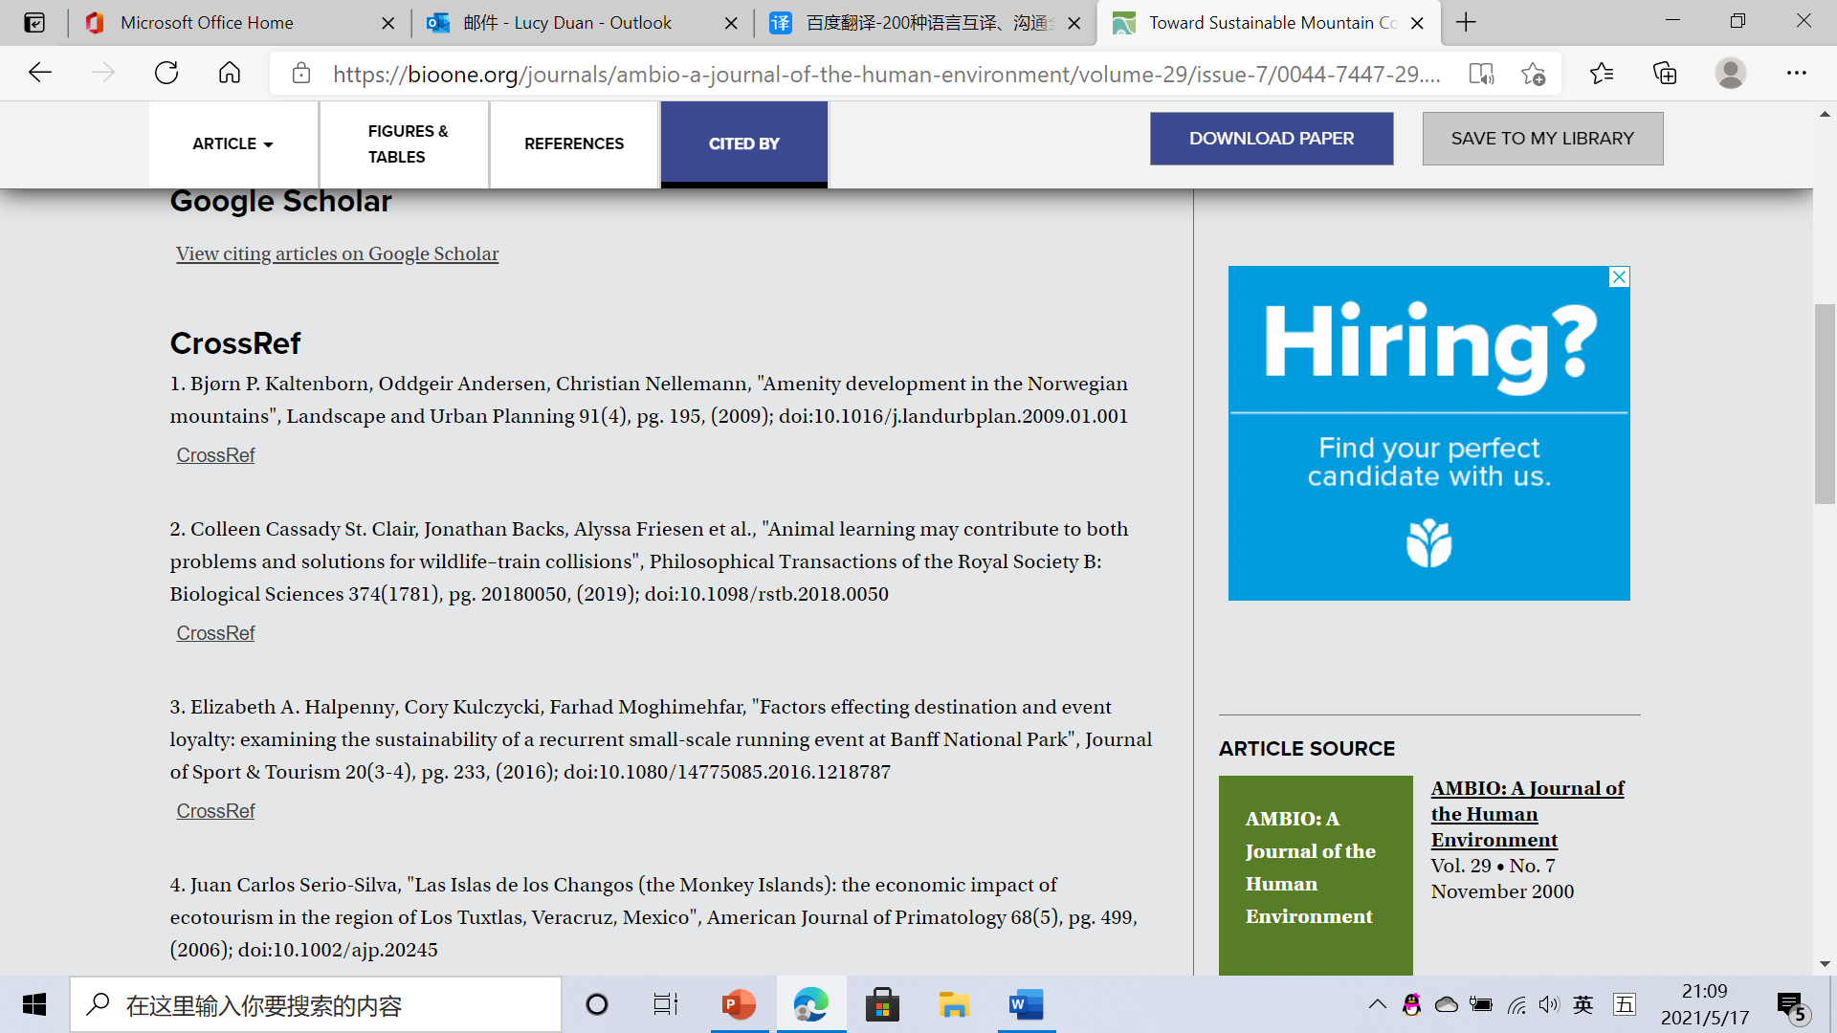
BioOne Complete 篇章浏览
该篇文章被引用情况

Slide 34
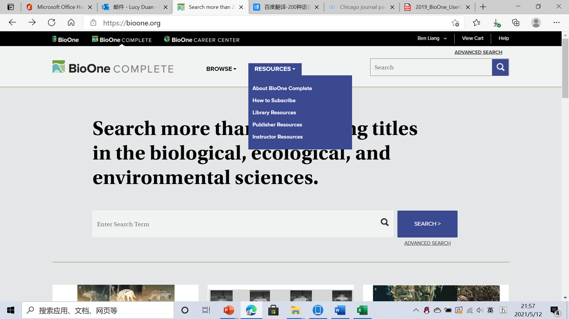
BioOne 资源导航

Slide 35
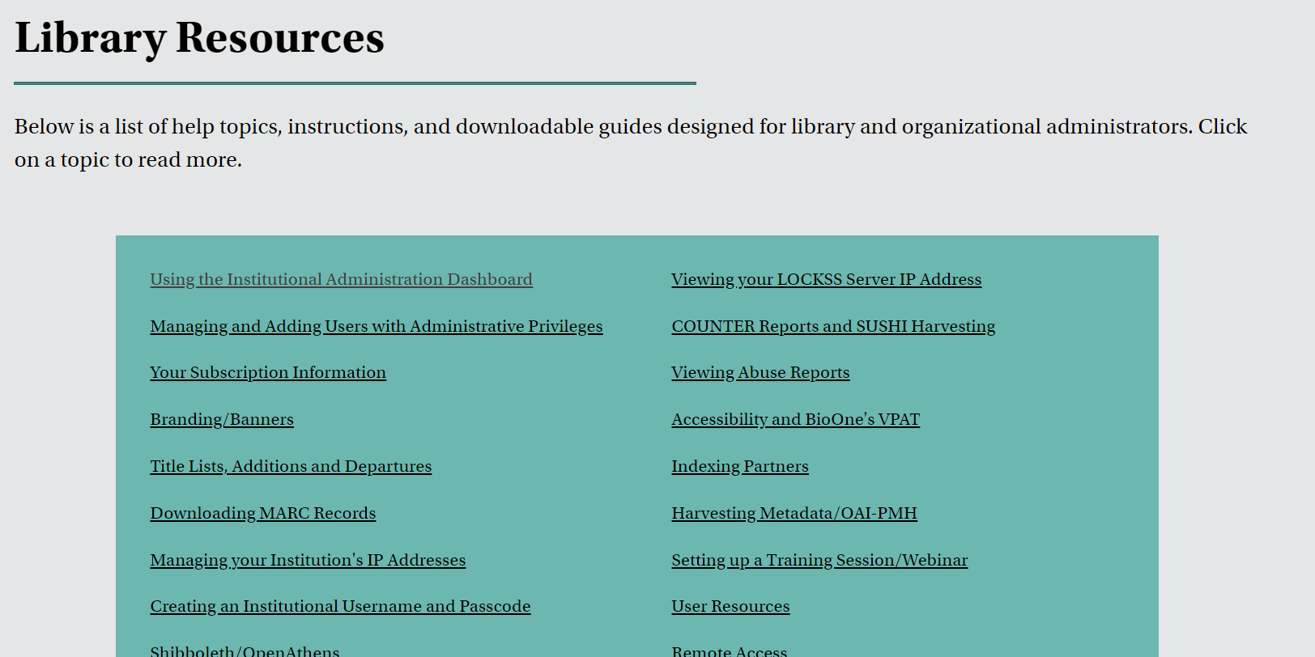
BioOne Complete 资源导航

Slide 36
BioOne Complete 检索与高级检索
基础检索高级检索

Slide 37
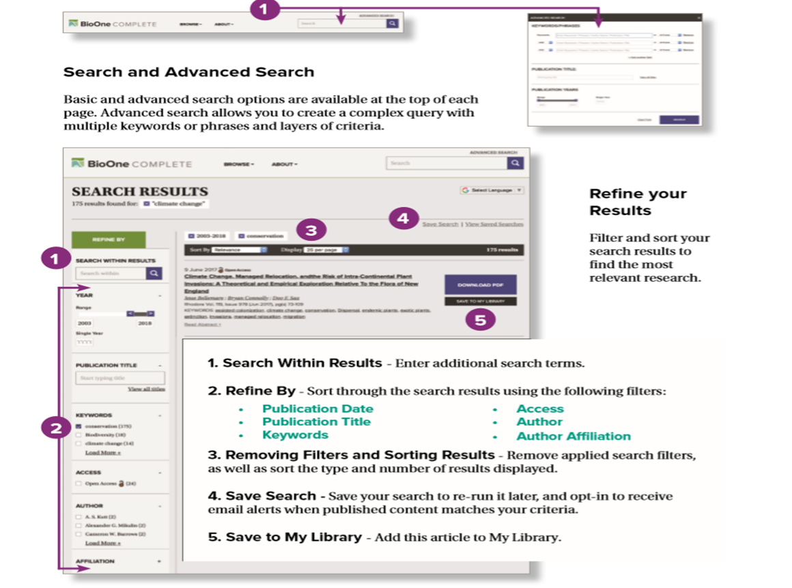
BioOne Complete 检索与高级检索

Slide 38
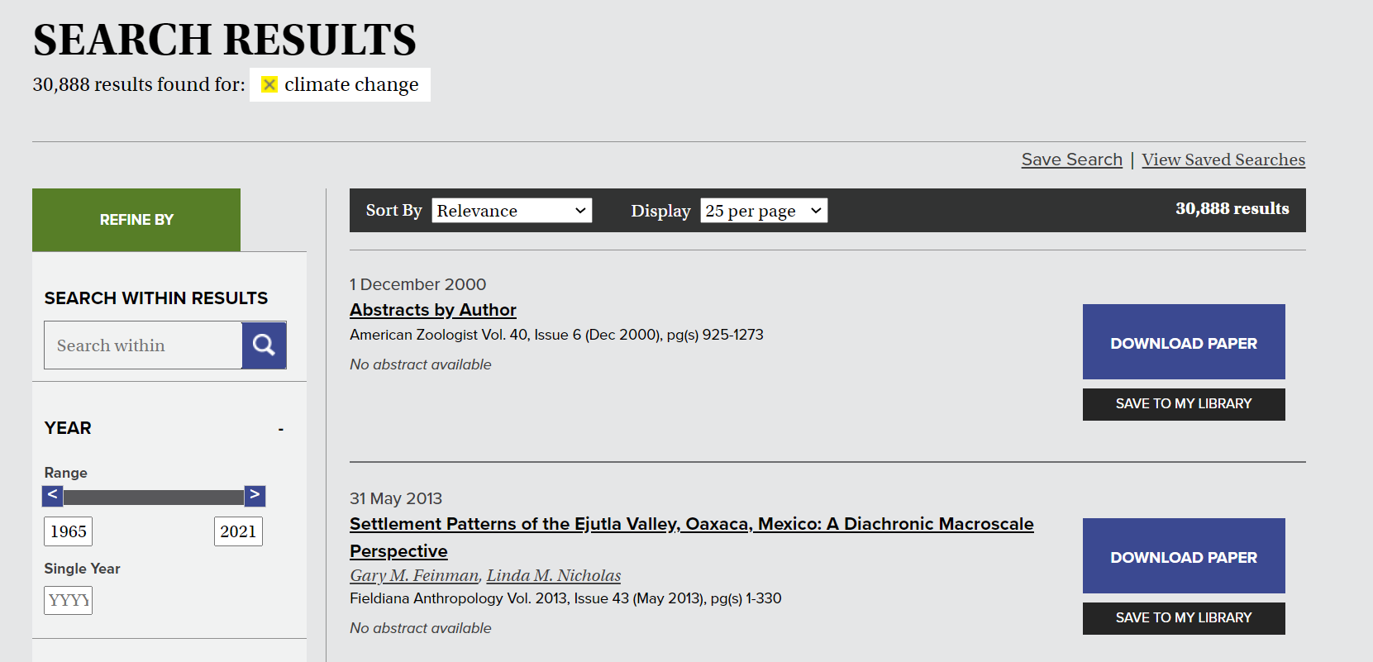
BioOne Complete 检索与高级检索
增加新的检索条件，在结果内进行检索

Slide 39
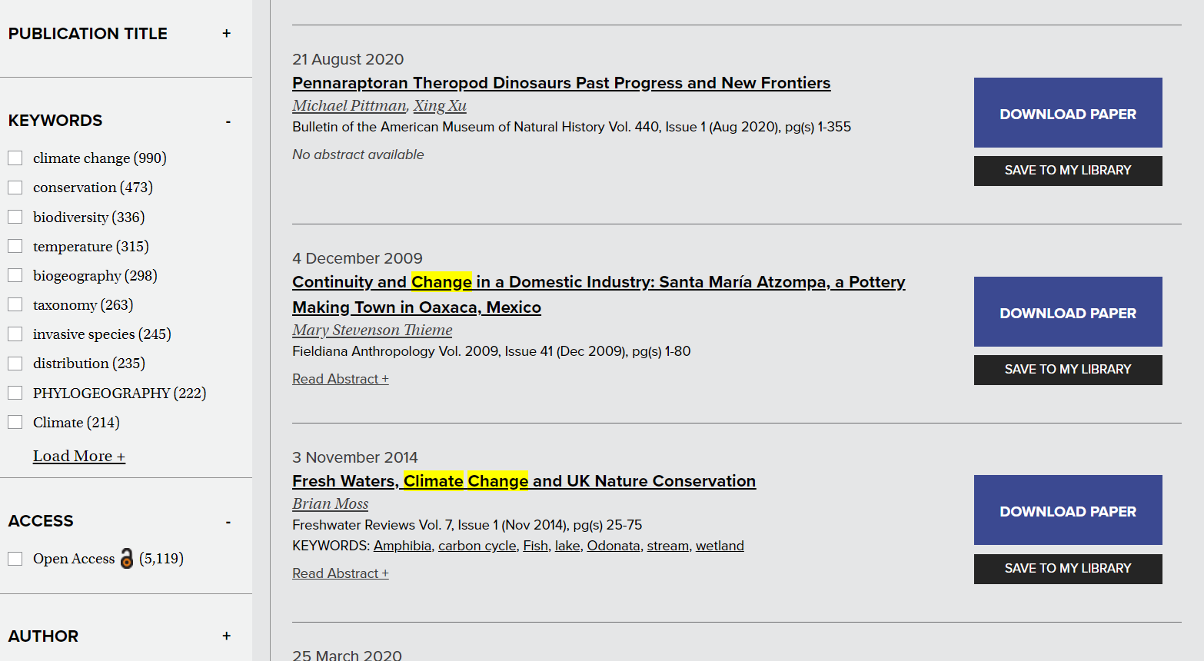
BioOne Complete 检索与高级检索
使用以下筛选器按排序优化搜索结果：
•出版日期
•出版物标题
•关键词
•访问情况
•作者
•作者从属关系

Slide 40
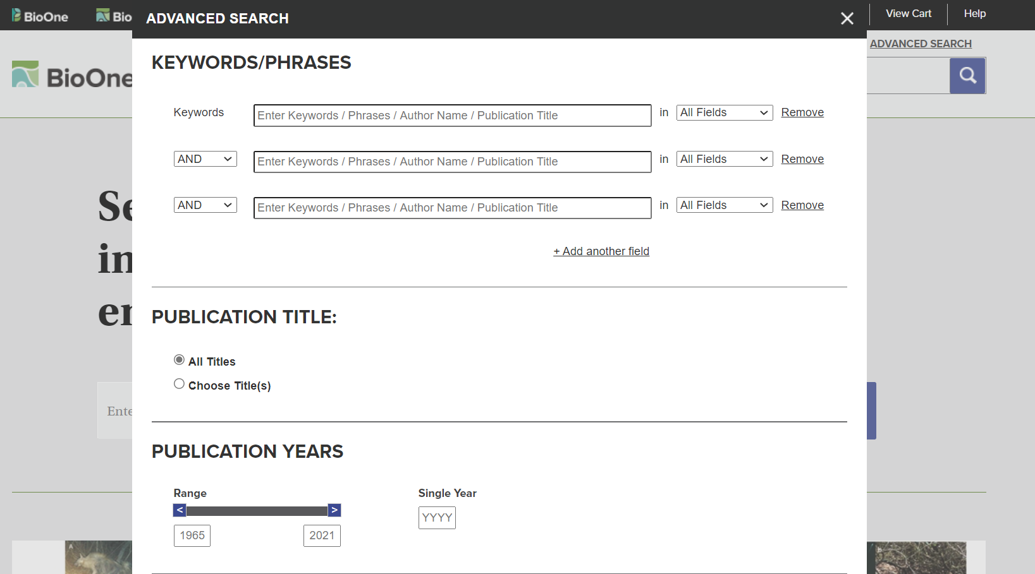
BioOne Complete 检索与高级检索

Slide 41
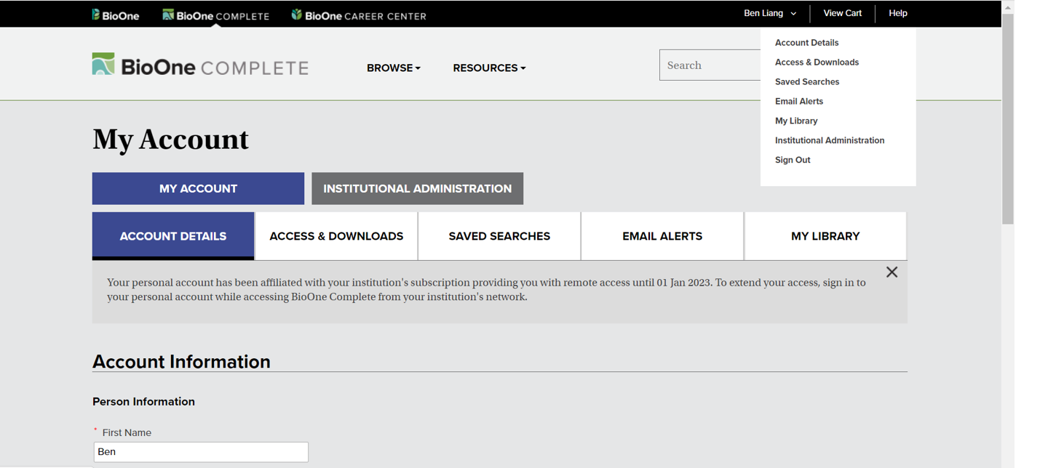
BioOne Complete 个人帐户的使用
个人信息及密码
查看有访问权限的期刊列表
查看、管理和重新访问保存的搜索条件
管理新内容、勘误表、引用和已保存搜索的自定义邮件提醒
保存文章到“我的图书馆”

Slide 42
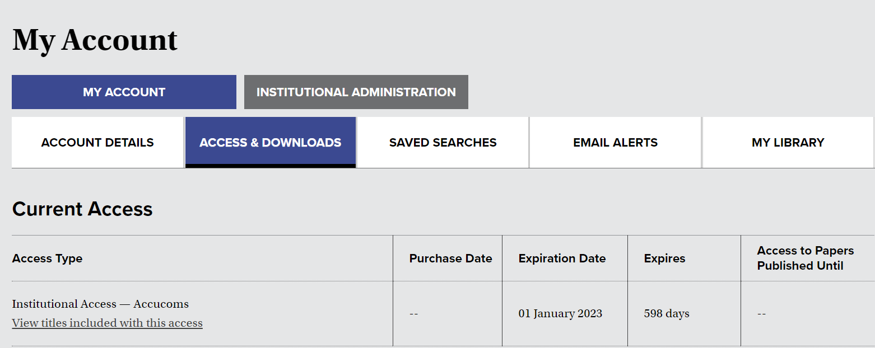
BioOne Complete 个人帐户的使用
查看有访问权限的期刊列表

Slide 43
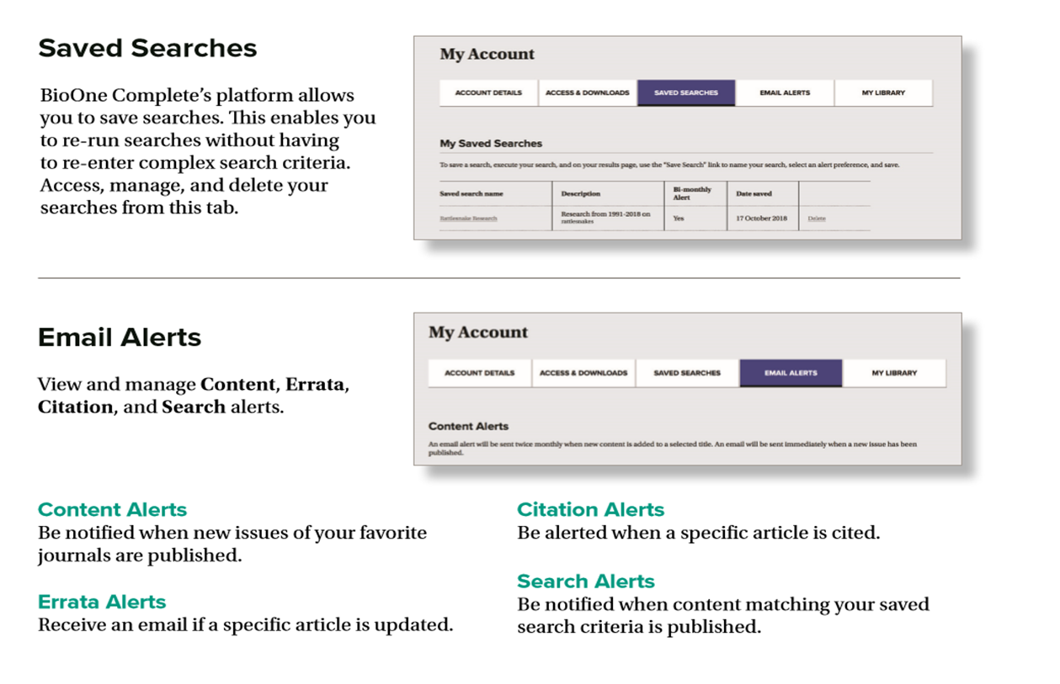
BioOne Complete 个人帐户的使用

Slide 44
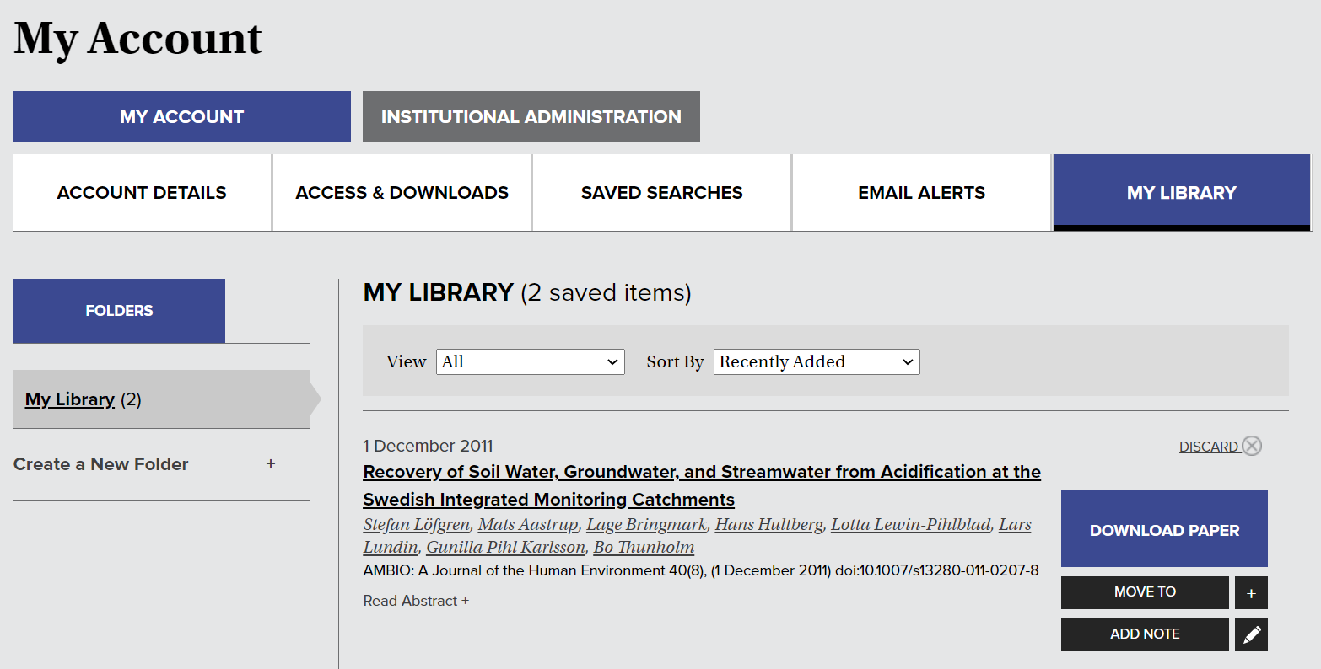
BioOne Complete 个人帐户的使用
按条件分类
创建文件夹
下载PDF文章、移动到文件夹、添加备注

Slide 45
Thanks!

